Slide 2
Corporate Social Responsibility: The Perspective of Oil and Gas Companies
Alan Baguma

Slide 3
The What
What is Corporate Social Responsibility?
Cambridge Dictionary (Online):
“the idea that a company should be interested in and willing to help society and the environment as well as be concerned about the products and profits it makes”
Collins Dictionary (Online):
“the incorporation of ethical elements, such as the public interest and environmental concern, into the planning of business strategy”
Business Dictionary (Online):
“A company's sense of responsibility towards the community and environment (both ecological and social) in which it operates”

Slide 4
The What
Examples of CSR activities include:
Philanthropic activities such as blood donation drives, cancer runs, charitable donations for good causes, etc.
Community wellness activities such as provision of access to clean water, public toilets and sanitation, mosquito nets and sanitary pads.
Infrastructure developments such as construction of roads, health and education facilities, police posts, etc.
Skills and capacity building through trainings and academic scholarships.
Promotion of agriculture through provision of agricultural inputs.

Slide 5
The Why
Why is Corporate Social Responsibility necessary?
Mandatory legal compliance considerations
With particular regard to environmental aspects and training, the upstream and midstream laws and regulations make this mandatory, e.g.;
S. 3(1) requires compliance with the environmental principles prescribed by the National Environment Act and other applicable laws (Midstream Act). A similar provision exists under the Upstream Act.
S. 54 and 55 of the Midstream Act and S.126 and 127 of the Upstream Act place an obligation on licensees to carry out training of Ugandans in accordance with a submitted program.

Slide 6
The Why
Social considerations
A debt to the Community (Corporate citizenship)
In addition to compensation paid to PAPs the I(N)OCs are cognizant of the fact that a fundamental change in the livelihood of the community occurs when a project commences, hence the need to give back to the community.
Compensation and livelihood restoration measures can never be 100% sufficient to cover issues that cannot be adequately quantified with money, hence CSR strikes a good balance.

Slide 7
The Why
Social considerations
Community buy-in
CSR builds a stronger bond between the community and the project. This ensures less opposition to the project during its long existence, less risk of sabotage and additional security for the project during its lifetime before decommissioning.
May mitigate the magnitude of the backlash from public before and after accidents and disasters. (Recent disasters include the BP-Deepwater Horizon rig oil spill in April 2010 with an estimated 4.9m barrel discharge, the largest spill ever (over $40bn in settlements paid); and the Royal Dutch Shell oil spill of 2008-9 in Bodo Community Nigeria ($84m settlement paid).

Slide 8
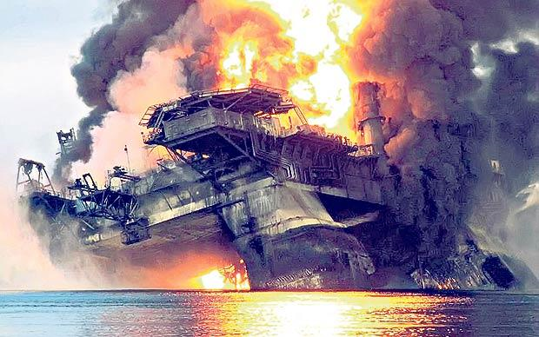
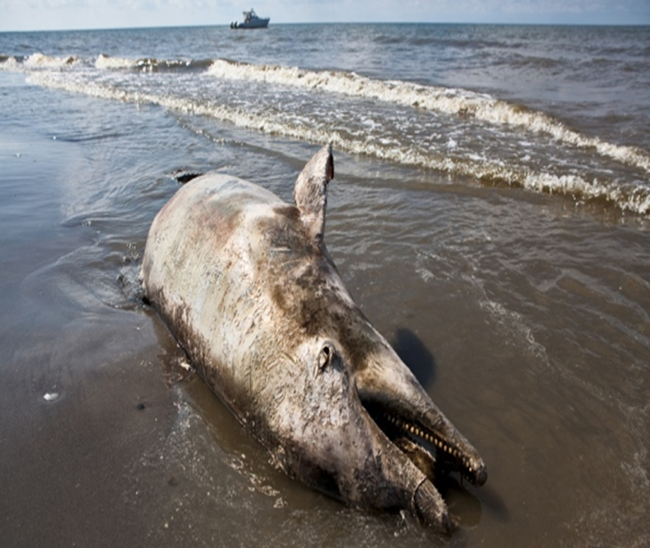
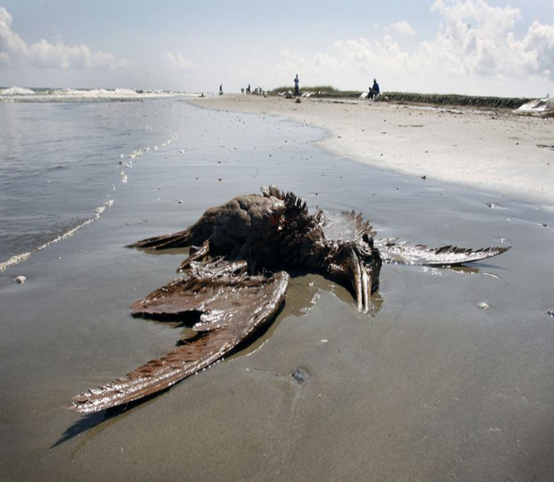
The Why
BP Deep Water Horizon Oil Spill-Gulf of Mexico 2010

Slide 9
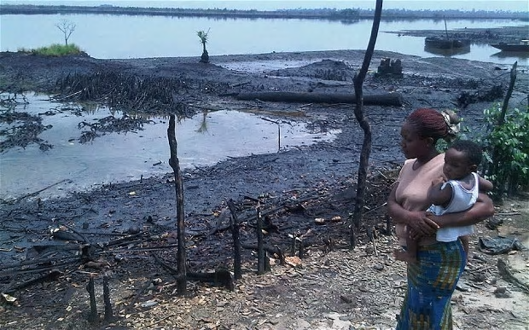
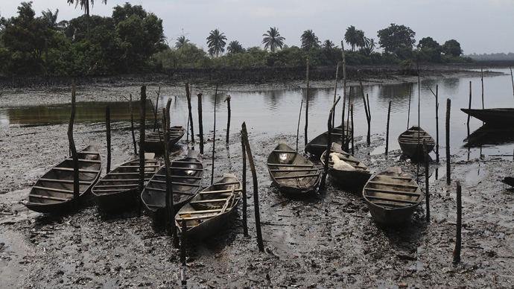
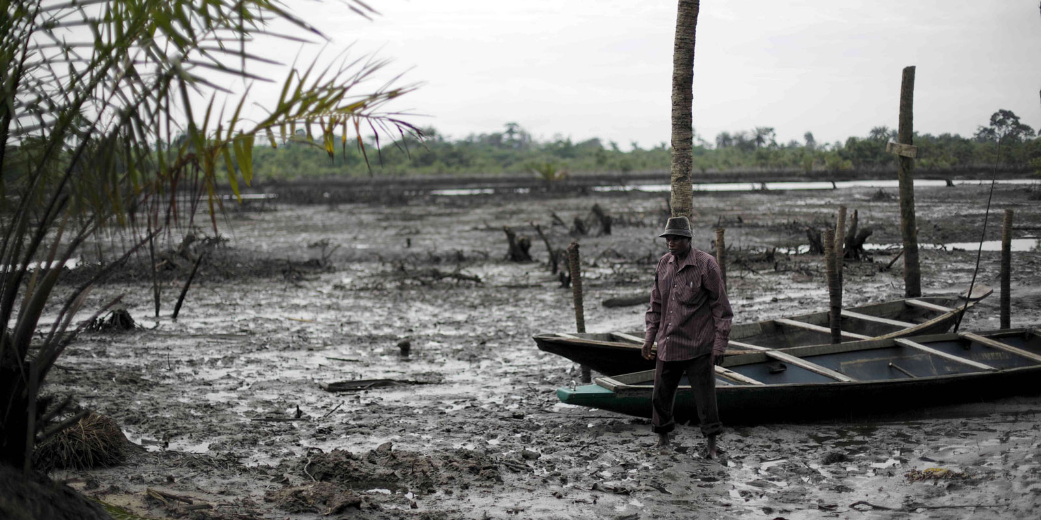
The Why
Royal Dutch Shell Oil Spill-Bodo, Nigeria 2008-9

Slide 10
The Why
Business, brand and reputational benefits
Enhanced positive reputation/goodwill, hence increased value for shareholders, and possible growth in market share e.g. in downstream trading.
Companies are more likely to retain and attract the best staff when their brand is attractive and of a high reputation.
Better lobbying power for favorable legal reforms owing to better public acceptance ratings.

Slide 11
Which examples
Examples of CSR activities undertaken in Uganda (not exhaustive)
The Total Access to Solar project was launched in 2013 under the brand AWANGO with nearly 80,000 solar lamps distributed in Uganda.
UNOC partnered in a blood donation drive with the Uganda Blood Transfusion Services to donate blood aimed at boosting blood collection across the country. UNOC also maintains strong relations with Bunyoro Kingdom and has supported cultural activities such as the Empango.
CNOOC in June 2012, donated medicine worth Shs. 85 million to Ntoroko district Local Government in response to the cholera epidemic in the area. CNOOC has been rewarding the best performing students at Primary seven, O level and A level in Hoima District since 2012 with over 300 beneficiaries of the cash prizes and certificates.

Slide 12
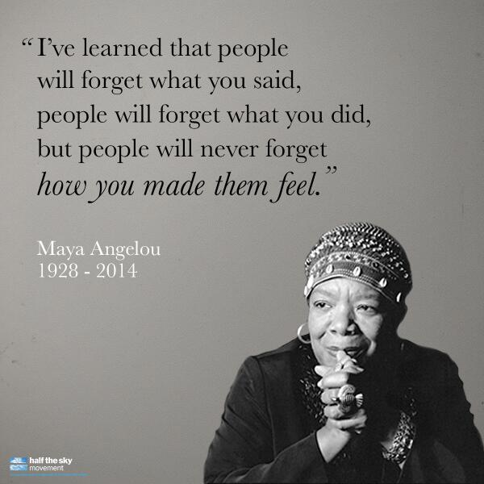
Conclusion

